Slide 1


Sault College
Accessibility Services Office
Testing Process

Slide 2
In This Guide:
Overview
Test Booking Process
Completing the Testing Request Form
Testing Rules
Academic Integrity / Dishonesty

Slide 3
Accessibility Testing: Overview
The Course Testing Service is provided by the Accessibility Services Office (ASO) in order to ensure fair opportunity for students requiring accommodations to demonstrate knowledge.
The following rules are designed to ensure that each student has the opportunity to complete his/her test in an environment suitable for his/her disabilities while ensuring test integrity.

Slide 4
Test Booking Process
Students may not be accommodated if they have not initiated the appropriate arrangements. Please complete all parts on the Testing Request Form.
Students must book their own tests with the ASO five (5) College business days in advance. Tests are written between 8:30 a.m. and 4:30 p.m. Tests for evening or late day classes will be scheduled into day time spares on your schedule. Evening testing from 4:30 to 7:30 is available on Thursdays only. Evening hours will also be available for finals. All final exams must also be booked five (5) college business days before the day of the exam.

Slide 5
Test Booking Process
After booking your test by submitting a complete and accurate Testing Request Form, you will receive a Booking Confirmation email from AccessibilityTesting@saultcollege.ca
The Booking Confirmation email is addressed to your faculty, and yourself. It includes the date and time that you have been scheduled to write your test.
Be sure to read these emails as test times and dates may be different than class times and dates.
Any conflicts must be addressed as soon as possible by replying to the booking Confirmation email.

Slide 6
Completing the Testing Request Form
In order to be accommodated for your testing, the Testing Request Form Must be completed fully and accurately.
Forms Must be submitted to Accessibility Services at least 5 Business Days before the class is scheduled to write the test.
Testing Request forms can be delivered in person to an Accessibility Testing Officer, or left in a dropbox located inside/outside student services.

Slide 7
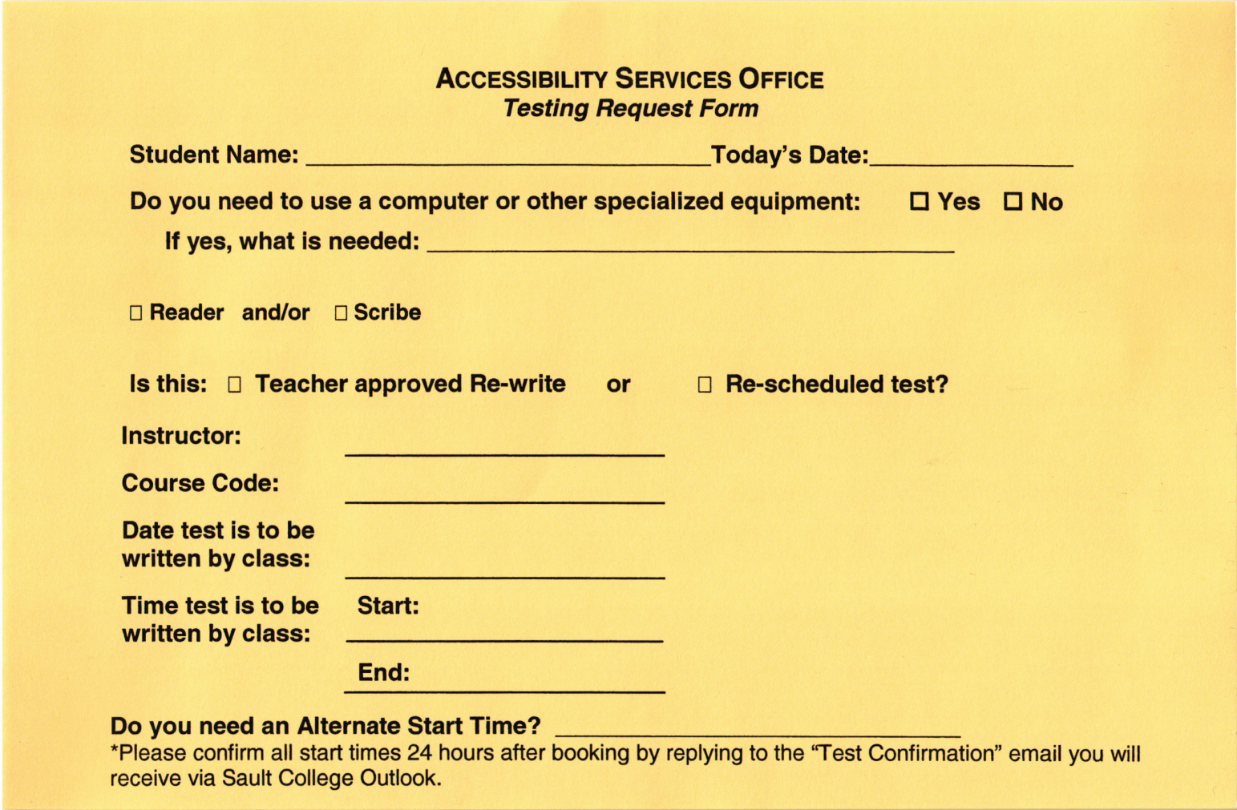
How to Complete the Testing Request Form

Slide 8

Step 1
Clearly Write Your Name and the date that you are Delivering the form to the Accessibility Office.
Please Print Clearly and Legibly

Slide 9
Step 2
Indicate if you need technology to complete the test. This includes assistive technology such as Dragon or Kurzweil, as well as Program specific software and Word Processing software.
Indicate yes or no and describe the Technology required in the line provided.

Slide 10
Step 3
If your accommodations include access to a Reader or Scribe, and you wish to use this service for the test being booked, indicate the required service in the checkboxes provided.
If not, please leave this section blank.

Slide 11
Step 4
If you have received permission from faculty to re-write a test which you have already completed, or missed choose “Teacher Approved Re-write”

Slide 12
Step 5
Check this box if the date or time of a test has been changed by your faculty and you have already submitted a Testing Request Form and received a “Booking Confirmation” email
Rescheduled tests require new Testing Request Forms to be submitted

Slide 13
Step 6
Print the first and last name of the faculty member who is giving the test.
This is the faculty member who will be contacted to provide your test.

Slide 14
Step 7
Print the alpha-numeric course code for the class for which the test is being written.
Your course codes are available on your student timetable.
eg. CMM110

Slide 15
Step 8
Print the Date on which the class is writing the test.
Date must include the Month and Numerical date, day of the week is not necessary.
Eg:
“September 12” or “Sept. 12, 2015”
not “Tuesday”

Slide 16
Step 9
Print the Time at which the class will be writing the test.
If the test is not starting at the beginning of scheduled class time this is very important.
If you are not certain, ask your faculty.

Slide 17
Step 10
Print the Time at which the class will be finished writing the test.
If faculty are teaching class after test time, we need to know!
If you are not certain, ask your faculty.

Slide 18
Step 11
Alternate start times are available if your class timetable does not allow for allotment of your extra time accommodations.
Tests cannot be rescheduled due to personal conflicts/reasons without faculty approval.
Please indicate if an alternate testing appointment is required.
Recommendations for alternate times are encouraged, but will still be subject to change due to resource availability.

Slide 19
Testing Rules
The following is an abbreviated list of Testing Center Rules.
A full list is available on the Student Portal here:
http://www3.saultcollege.ca/Portal/FormsPolicies/Accessibility%20Testing%20Rules.pdf

Slide 20
Students are expected to arrive on time and prepared for a scheduled test. If a student is late, the test will have to be rescheduled or started late with the verbal/written permission of the professor. The permission slip is then attached to the completed test.
The student must bring his or her student ID card (or valid photo ID) for admission into the test room.
Once the test commences, the student will not be allowed to leave the test room unaccompanied (use the washroom prior to your test appointment)

Slide 21
  Items to Bring:
  Pencils
  Pens
  Erasers
  Notes/Text (If permitted for the test)
  Specialized equipment that has been previously identified (special rulers, charts) by the professor will be permitted.
  Do NOT Bring:
  Coats, hats, book bags
  Pencil cases, pens, binder paper
  Rulers
  Cell phones (will be turned off and secured)
  Electronic devices such as MP3 players, iPods, Smartwatches, etc...
  Programmable spellcheckers, calculators, organizers
  Leave these items in your locker, they will not be allowed in the test rooms

Slide 22
Academic Integrity / Dishonesty
If any observation of Academic Dishonesty occurs during a test in the Accessibility Services Office, the test will be stopped; all materials will be removed from the room and filed for the teacher to pick up.
Any decision about Academic Dishonesty will be made by course faculty.
Issues of concern should always be discussed with your Counsellor.

Slide 23
For More Information
Contact:
AccessibilityTesting@saultcollege.ca
Visit Student Services room E1101, or
Visit Your Academic Counsellor

